Slide 1
IPFS
Interplanetary File System

Slide 2
Interplanetary File System:
IPFS is a protocol designed to create a permanent and decentralized method of storing and sharing files.
It’s a peer-to-peer (p2p) filesharing system that aims to fundamentally change the way information is distributed across & beyond the globe.
IPFS seeks to create a permanent and distributed web. It does this by using a content-addressed system instead of HTTP’s location-based system.
IPFS is more Faster, safer and more open web

Slide 3
How IPFS Works
1) Distributed Hash Bables (DHT):
IPFS Storing and sharing the files by using distributed hash tables (DHT). Hash table is a data structure that stores information as key/value pairs.
In distributed hash tables (DHT) the data is spread across a network of computers, and efficiently coordinated to enable efficient access and lookup between nodes.
The main advantages of DHTs are in decentralization, fault tolerance and scalability.

Slide 4
2) Merkle DAG:
A merkle DAG is a blend of a Merkle Tree and a Directed Acyclic Graph (DAG). Merkle trees ensure that data blocks exchanged on p2p networks are correct, undamaged and unaltered.
This verification is done by organizing data blocks using cryptographic hash functions. This is simply a function that takes an input and calculates a unique alphanumeric string (hash) corresponding with that input.
It is easy to check that an input will result in a given hash, but incredibly difficult to guess the input from a hash.

Slide 5
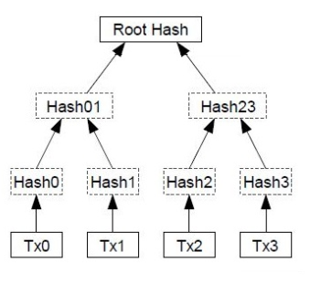
Merkle DAG Files Store Structure:

Slide 6
3) Version Control Systems (VCS):
IPFS is allows you to build a distributed version control system (VCS). For Ex: Github: Peers supporting the database have different versions of the history from time to time. They keep only the highest-scoring version of the database known to them.
The Github is allows developers to easily collaborate on projects simultaneously.
Files on Github are stored and versioned using a merkle DAG. It allows users to independently duplicate and edit multiple versions of a file, store these versions and later merge edits with the original file.

Slide 7
Conclusion:
IPFS is used as a complementary file system for public blockchains and other p2p applications.
At the time of writing it can cost several dollars to store a kilobyte of data in an Ethereum smart contract. This is a major constraint and there is currently massive growth in new decentralized apps (DApps) being launched. IPFS is interoperable with smart contracts and blockchain data, so it can add reliable, low-cost storage capacity.
IPFS is a both technically and conceptually complex protocol that has lofty ambitions to revolutionize the exchange of data across the Internet.

Slide 8
Thank You ............!

